Slide 1
Python

Slide 2
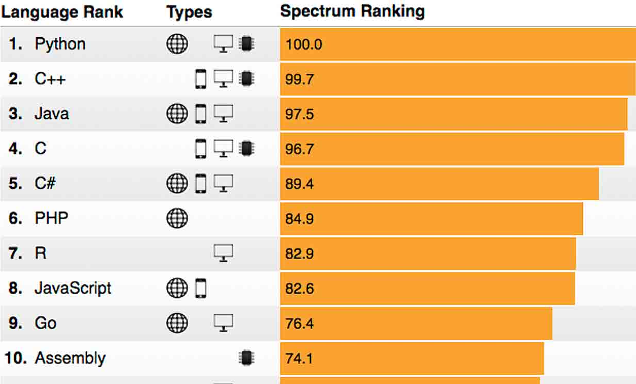

Slide 3
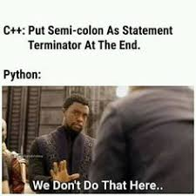
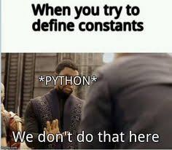
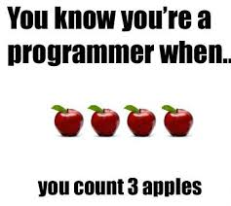

Slide 4
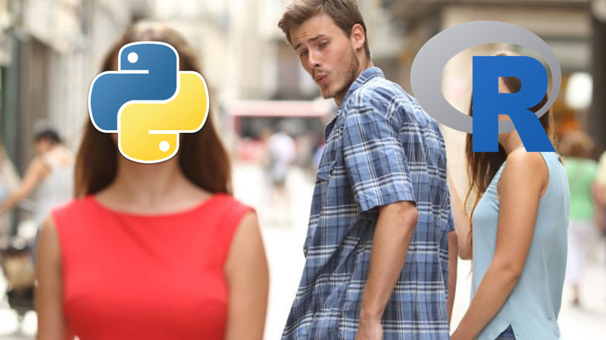

Slide 5
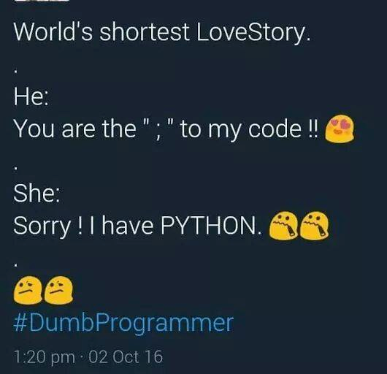

Slide 6
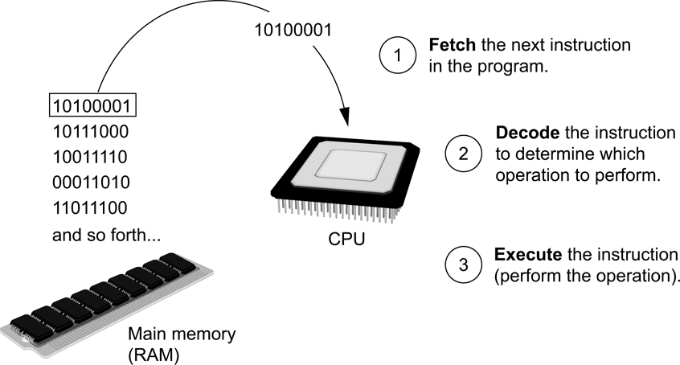
How a Program Works
Fetch-decode-execute cycle is the term used when the CPU executes the instructions in a program.
The cycle consist of three steps:
Fetch
Decode
Execute
Figure The fetch-decode-execute cycle

Slide 7
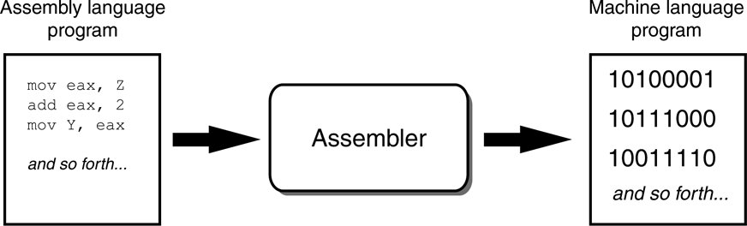
How a Program Works
From Machine Language to Assembly Language
Computers only understand machine language
Machine language is difficult to write
Assembly language uses short words that are known as mnemonics
Assembler is used to translate an assembly language program to machine language
Figure An assembler translates an assembly language program to a machine language program

Slide 8
How a Program Works
High-Level Languages
Assembly language is referred to as a low-level language
High-level languages allow you to create powerful and complex programs without knowing how the CPU works, using words that are easy to understand.
For example:
Ada, BASIC, Python, C++, Ruby, Visual Basic
Do you know of any other high-level computer programming languages?

Slide 9
How a Program Works
Key Words, Operators, and Syntax: an Overview
Key words or reserved words have specific meaning and purpose in the programming language
Operators perform various operations on data
Syntax is a set of rules that must be strictly followed when writing a program
Statements are individual instructions written in a programming language

Slide 10
How a Program Works
Compilers and Interpreters
The statements written in a high-level language are called source code or simply code
Source code is translated to machine language using a compiler or an interpreter
Syntax error is a mistake such as a:
Misspelled word
Missing punctuation character
Incorrect use of an operator

Slide 11
Using Python
The Python Interpreter
A program that can read Python programming statements and execute them is the Python interpreter
Python interpreter has two modes:
Interactive mode waits for a statement from the keyboard and executes it
Script mode reads the contents of a file (Python program or Python script) and interprets each statement in the file

Slide 12
Using Python
Interpreter Mode
Invoke Python interpreter through Windows or command line
>>> is the prompt that indicates the interpreter is waiting for a Python statement
>>> print ‘Python programming is fun!’
Python programming is fun!
>>>
Statements typed in interactive mode are not saved as a program
[ENTER]

Slide 13
Using Python
Writing Python Programs and Running Them in Script Mode
Use a text editor to create a file containing the Python statements
Save the file with a .py extension
To run the program:
>>> python test.py
[ENTER]

Slide 14
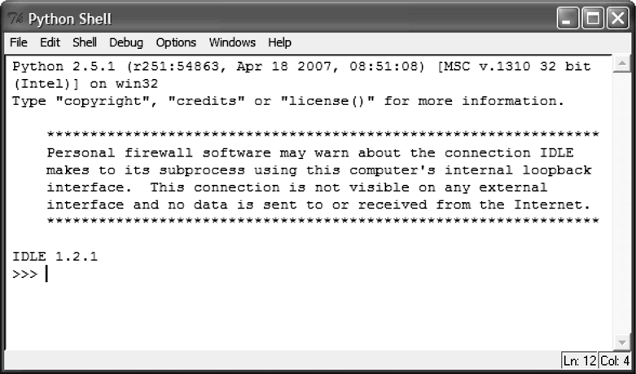
Using Python
The IDLE Programming Environment
Integrated DeveLopment Environment (IDLE)
Automatically installed when Python language is installed
It has a built-in text editor
IDLE editor colorizes code
Figure IDLE

Slide 15
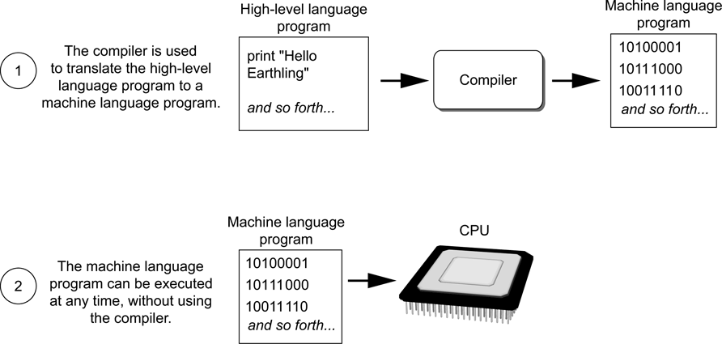
How a Program Works
Compilers and Interpreters
Compiler is a program that translates a high-level language program into a separate machine language program
Figure Compiling a high-level program and executing it

Slide 16
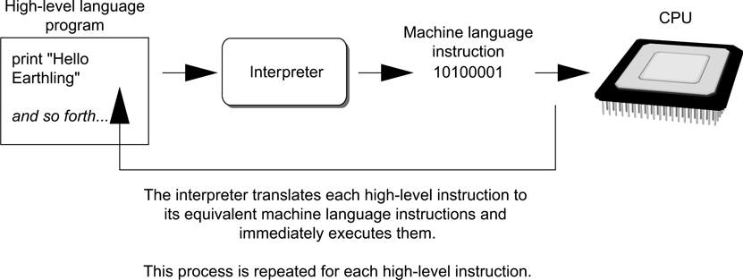
1.4 How a Program Works
Compilers and Interpreters
An interpreter is a program that both translates and executes the instructions in a high-level language program
Figure Executing a high-level program with an interpreter

Slide 17
1.5 Using Python
Concept:
The Python interpreter can run Python programs that are saved in files, or can interactively execute Python statements that are typed at the keyboard. Python comes with a program named IDLE that simplifies the process of writing, executing, and testing programs.

Slide 18
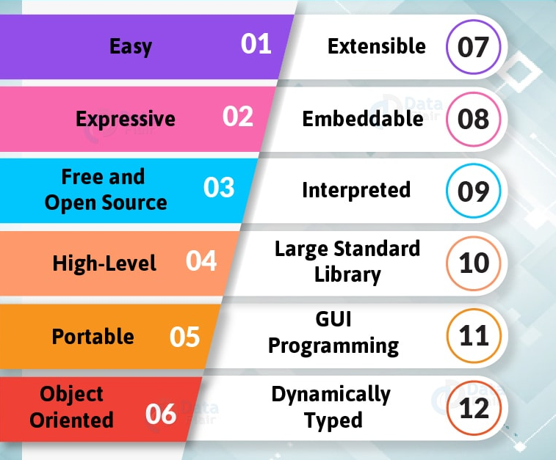

Slide 19
